Slide 1
Customer Review Analysis
British Airways

Slide 2
About the Data:
The dataset contains 3,000 customer reviews from various seat types (Business, Economy, First, and Premium Economy) with ratings ranging from 1 to 10, highlighting passenger experiences and satisfaction levels over multiple years.
The data includes temporal details (day, month, year) and textual feedback, allowing for the analysis of trends, patterns, and sentiment over time.
Insights derived can guide strategic decisions to improve customer satisfaction and address common service issues highlighted in the reviews.

Slide 3
Insights:
Distribution of Rating
No. of Reviews by Year
No. of Reviews by Seat Type
Rating according to Seat Type
Rating according to Year
Rating according to Month
Rating according to Week
No. of Reviews by Year w.r.t Seat Type
Average Rating by Year and Seat Type
Sentiment Analysis:
WordCloud for Positive Reviews
WordCloud for Neutral Reviews
WordCloud for Negative Reviews

Slide 4
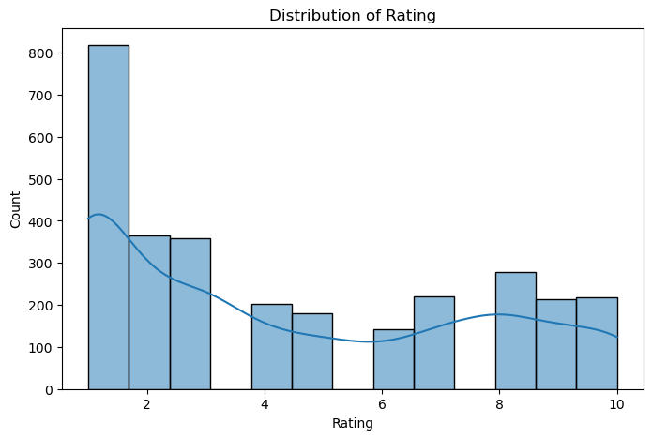
Distribution of Rating:
Interpretation:
The distribution appears somewhat bimodal, with one peak at the very low end (rating 1) and a smaller peak around ratings 8 or 9. This pattern might indicate polarized user experiences—some users are extremely dissatisfied, while a smaller group is quite satisfied.
The data indicates a high level of dissatisfaction among users, with the most common rating being 1
However, there is a smaller but noticeable group of users who are satisfied, giving ratings of 8 or higher.
The distribution suggests a significant variance in user experiences, possibly indicating inconsistencies in service or product quality.

Slide 5
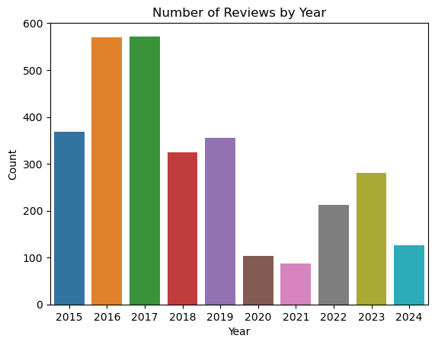
No. of Reviews by Year:
Interpretation:
The data shows a fluctuating pattern in the number of reviews over the years, with a peak in 2016-2017
A significant decline during 2020-2021 likely due to external disruptions, and a gradual recovery in subsequent years.
The decline in 2024 suggests a possible new trend or an incomplete data year.

Slide 6
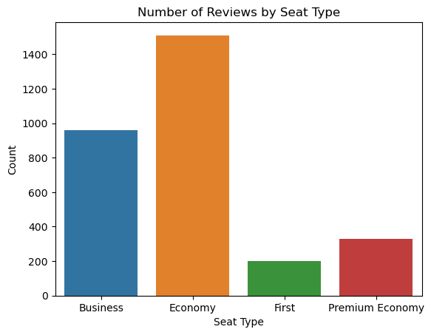
No. of Reviews by Seat Type:
Interpretation:
Economy class dominates likely due to its affordability and accessibility for most travelers.
Business class has the second highest number of reviews, indicating that a substantial number of passengers are opting for Business class, potentially for its enhanced comfort and services.
Lower Review Counts for First and Premium Economy, highlighting its exclusivity and lower passenger volume.

Slide 7
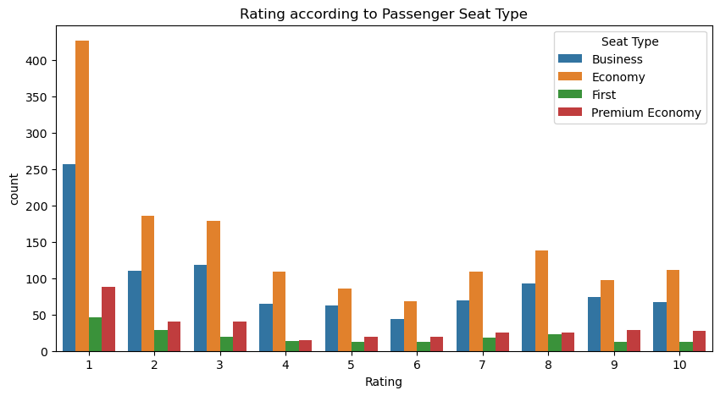
Rating according to Seat Type:
Interpretation:
Passenger experience or satisfaction varies significantly with seat type, with Economy passengers contributing most to low and high ratings, indicating polarized experiences.
Rating 1: The majority of passengers who gave a rating of 1 were seated in the Economy class, followed by Business, Premium Economy, and then First class.
Rating 2 to 4: Economy class consistently dominates in these lower rating categories, though the number of passengers decreases as the rating increases. Business class is the second most common seat type in these ratings.
Rating 5 to 7: There is a noticeable rise in the number of passengers from all seat types giving these mid-range ratings, especially in Economy and Business classes.
Rating 8 to 10: High ratings (8-10) still see Economy as the leading seat type but with a higher proportion of Business and First class passengers compared to lower ratings. Premium Economy remains the least common seat type throughout.

Slide 8
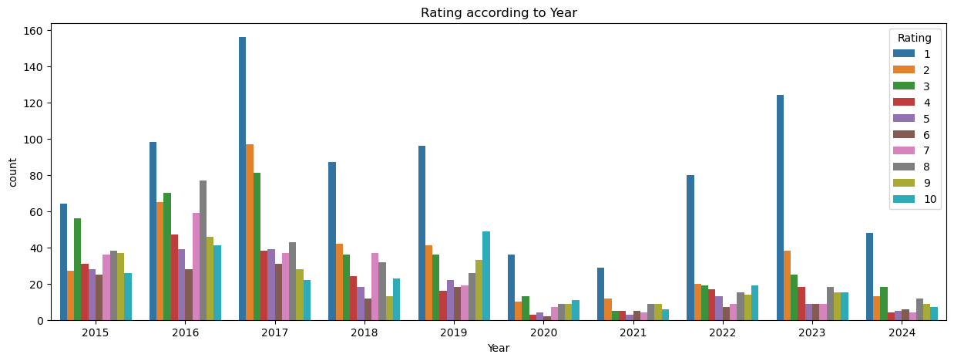
Rating according to Year:
Interpretation:
Overall, there is a clear dominance of low ratings (particularly rating 1) throughout the years, with peaks in 2017, 2019, and 2023.
There is a sharp decline in 2020-2021, which aligns with the travel disruptions caused by the COVID-19 pandemic.
Despite fluctuations, passenger satisfaction appears consistently polarized, with significantly more lower ratings, especially rating 1, across most years.

Slide 9
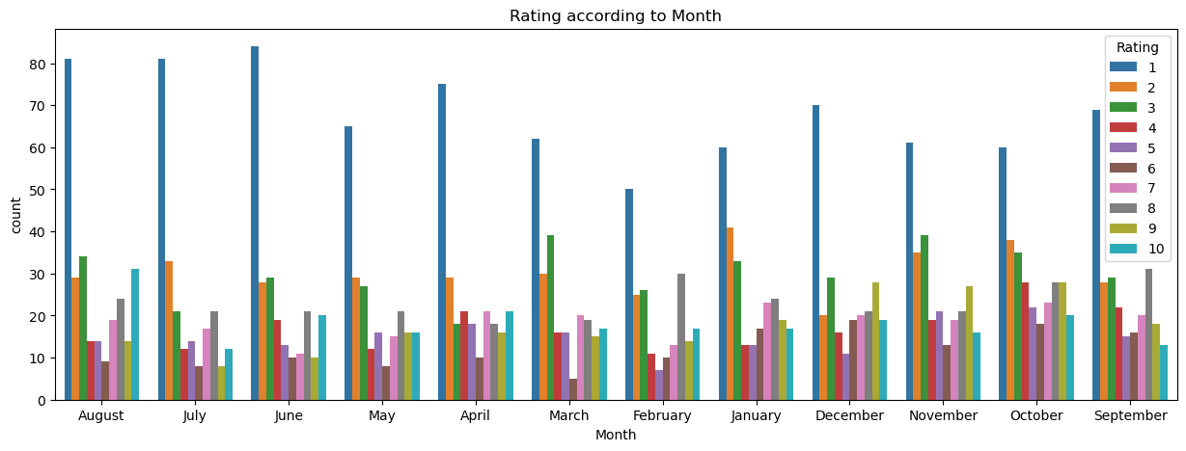
Rating according to Month:
Interpretation:
The chart highlights a trend of low passenger satisfaction throughout the year, with rating 1 being the most common score in all months.
While high ratings do occur, they are much less frequent, indicating a need for improvements in passenger experiences across all months.
The patterns are consistent, suggesting systemic issues rather than seasonal variations as the primary driver of dissatisfaction.

Slide 10
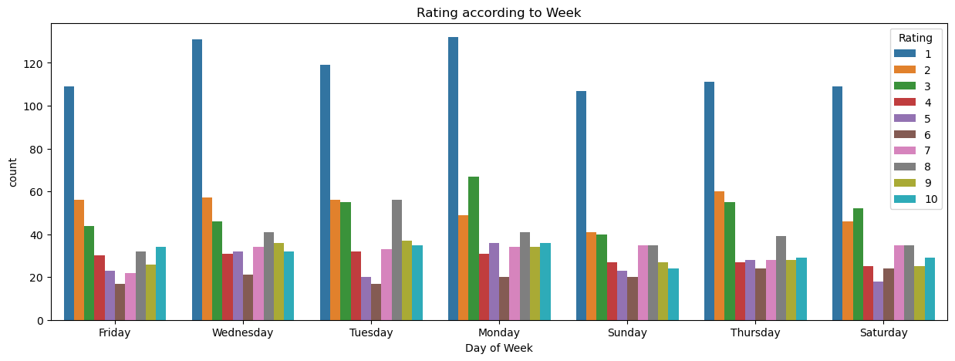
Rating according to Week:
Interpretation:
Passenger experiences lead to low ratings, are a common trend across all days of the week, with Wednesday seeing the highest number of reviews.
The distribution does not vary significantly between days, highlighting a general trend of customer dissatisfaction regardless of the day of travel.
High ratings, though less common, are present across all days, suggesting varied passenger experiences.

Slide 11
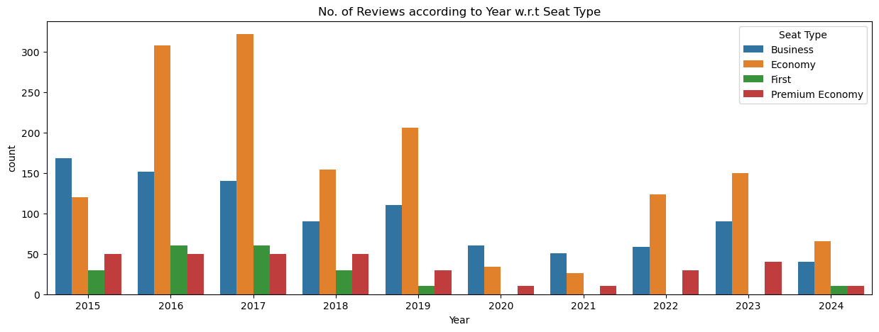
No. of Reviews by Year w.r.t Seat Type:
Interpretation:
The peak review periods for all seat types are between 2015 and 2019, particularly for Economy and Business classes.
There is a visible impact of the pandemic on ratings from 2020 to 2021, with a significant drop in the count for all seat types.
Economy class remains dominant throughout the period, indicating that it is the most utilized seat type among passengers or receives the most feedback.
The gradual increase in ratings post-2021 suggests a recovery in passenger reviews, possibly aligning with the resumption of more regular travel patterns.

Slide 12
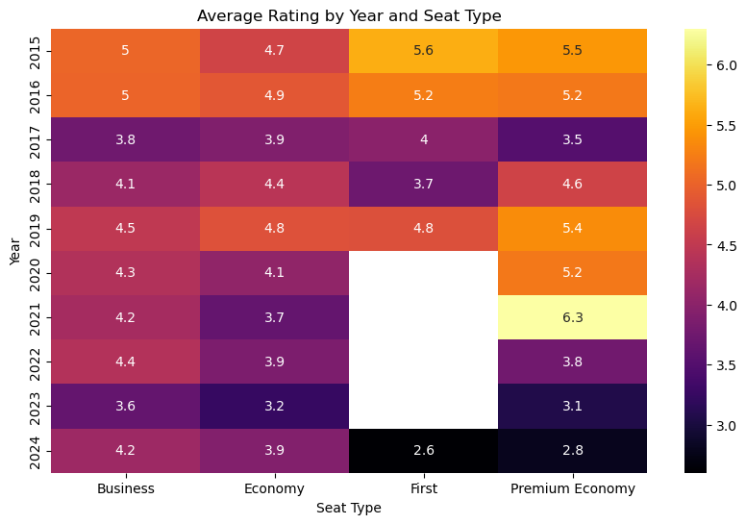
No. of Reviews by Year:
Interpretation:
The heatmap highlights a declining trend in passenger satisfaction across all seat types over the years, with particularly sharp declines in First and Premium Economy in recent years.
The consistent downward trends suggest systemic issues affecting all classes, while some years show brief improvements, particularly for Premium Economy in 2021.
The variability and overall decline emphasize a need for service improvements across all seat types to enhance passenger satisfaction.

Slide 13
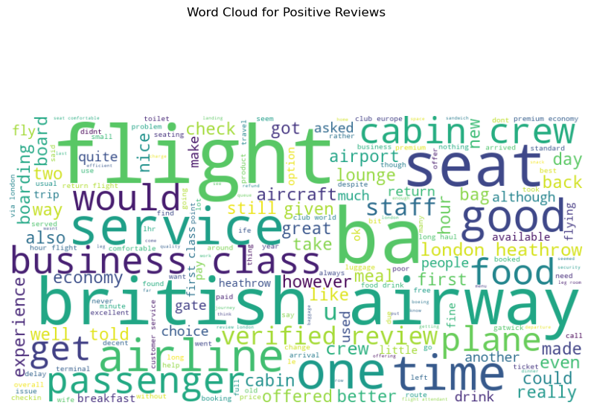
WordCloud (Positive Reviews):
Interpretation:
Words like "flight," "service," "seat," "crew," and "business class" are prominent, indicating that aspects related to seating comfort, in-flight service, and the performance of the crew are significant factors contributing to positive experiences.
The frequent appearance of terms such as "good," "nice," "lounge," and "food" further emphasizes the importance of quality service and amenities in enhancing customer satisfaction.
This visualization suggests that customers particularly appreciate a comfortable and efficient travel experience.

Slide 14
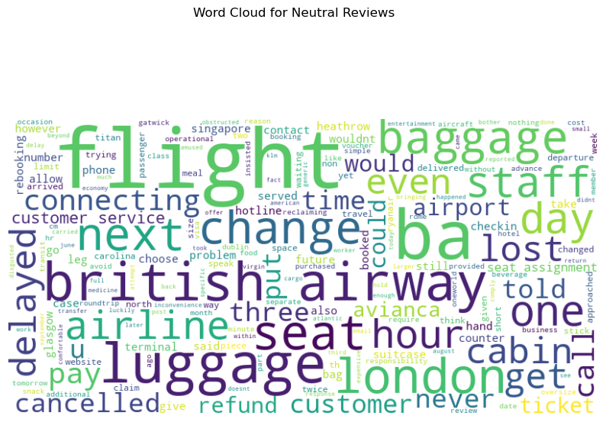
WordCloud (Neutral Reviews):
Interpretation:
The word cloud for neutral reviews shows frequent terms like "flight," "baggage," "seat," "staff," "change," and "connecting," which suggest a mix of average experiences and logistical aspects of travel.
Words such as "delayed," "lost," "pay," "luggage," and "canceled" indicate that these reviews often revolve around issues like schedule changes, baggage handling, and additional costs.
The presence of terms like "customer service" and "refund" also highlights customer interactions that were neither distinctly positive nor negative, pointing towards areas of service that may require attention for improvements.

Slide 15
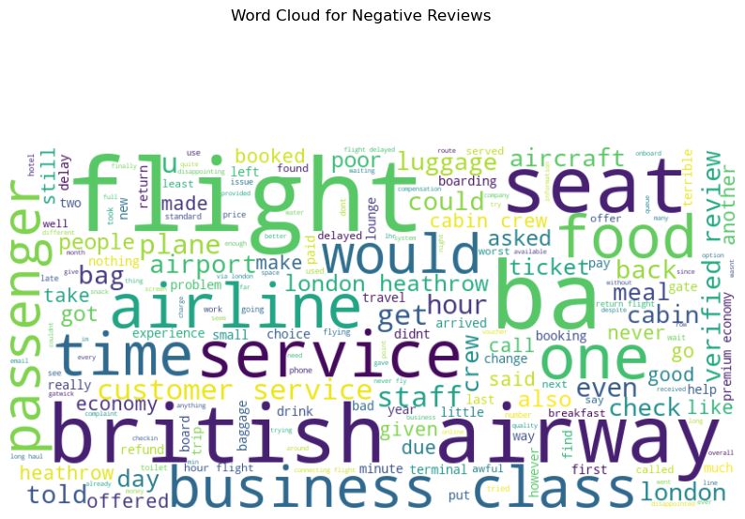
WordCloud (Negative Reviews):
Interpretation:
The word cloud for negative reviews highlights common issues with terms like "flight," "seat," "service," "food," "luggage," and "staff," indicating prevalent dissatisfaction among passengers.
Frequent mentions of words like "delayed," "poor," "customer service," "cabin," and "crew" suggest that the main complaints revolve around delays, poor service quality, and unsatisfactory interactions with staff.
The prominence of words such as "business class" and "premium economy" may reflect expectations not being met in higher service classes.

